Slide 1
Chapter 29 THREADS : INSTRUCTION
9 February, 2021
waterfog9580@gmail.com
rilac1@naver.com

Slide 2
Contents
Overview of thread?
Pthreads API
Creating a New Thread: pthread_create()
Terminating a Thread: pthread_exit()
Joining with a Terminated Signal: pthread_join()
Detaching a Thread: pthread_detach()
Threads vs Process

Slide 3
What is Thread?
Multi Processes
Multi Threads
data
files
data
files
data
files
registers
stack
registers
stack
registers
registers
registers
Thread
stack
stack
stack
code
code
code
code
code
프로세스 간 메모리 공유가 어렵다.
프로세스를 생성(fork) 하는데 비용이 많이 든다.
스레드 간 메모리 공유가 쉽고 빠르다.
스레드를 생성하는 것은 프로세스를 생성하는 것보다 횔씬 빠르다.

Slide 4


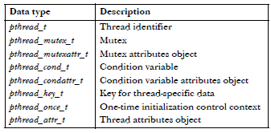
Background Details of the Pthreads API
Pthreads API
errno 가 전역변수가 아닌 함수 호출로 확장되는 매크로로 정의된다.
Pthreads API의 함수는 성공하면 0을 반환하고 실패하면 양수 값을 반환한다.
Pthreads API를 사용하는 프로그램은 컴파일시 cc –pthread 옵션을 사용해야 한다.

Slide 5
Thread Creation
int pthread_create(pthread_t *thread, const pthread_attrt_t *attr,
void *(*start)(void *), void *arg);
Process
thread : 스레드 식별자 (tid)
attr : 스레드 특성 (Null 가능)
start : 스레드 시작함수 포인터
arg : 함수에 들어갈 인자
main( ) { … }
pthread_create( )
start( ) { … }

Slide 6
Thread Termination
Process
When Terminate?
thread 시작함수가 종료될 때.
main 함수가 종료될 때. (모든 thread 즉시 제거됨)
thread call 사용 : pthread_exit()
main( ) { … }
pthread_create( )
start( ) { … }
void pthread_exit(void *retval);
retval : 스레드의 반환값

Slide 7
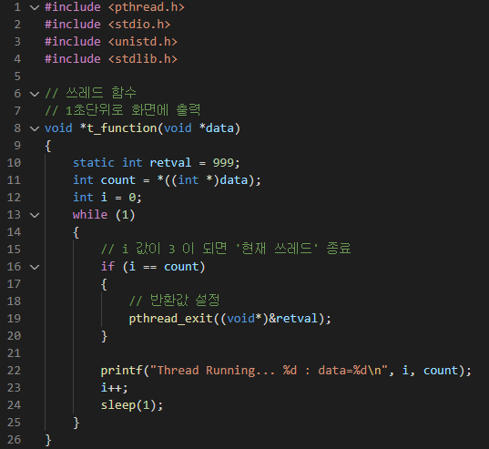
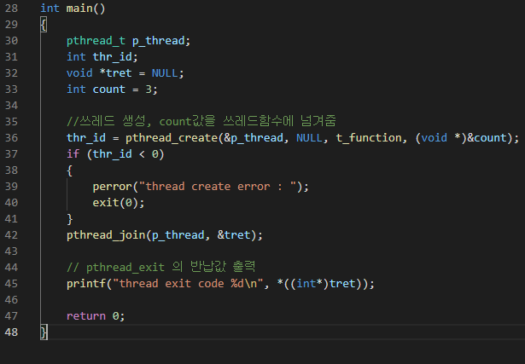

Thread Termination
int pthread_exit(void **retval);

Slide 8
Thread IDs
pthread_t pthread_self(void);
자신의 Thread ID 반환
int pthread_equal(pthread_t t1, pthread_t t2);
t1과 t2가 같은 값이라면 0이 아닌 값, 같다면 0 반환

Slide 9
Joining with a Terminated Thread
int pthread_join(pthread_t thread, void **retval);
thread_A
pthread_create(thread_B, ...)
thread_A
thread_B
pthread_exit(&retval) or return retval
pthread_create() pthread_join(B)
retval
pthread_exit(&retval)
thread_A
pthread_join(thread_B, &retval)
thread_B
working
sleep

Slide 10
Joining with a Terminated Thread
process(hierarchical relationship)
process
thread
process_A
process_C
fork
pthread_create
fork
can wait
can’t wait
process_B
thread(peer)
return/exit
return/pthread_exit
thread_A
process_C
waitpid
pthread_join
pthread_create
can wait
can wait
thread_B

Slide 11
Detaching a Thread
int pthread_detach(pthread_t thread);
Joinable(=Default)
Detached
1. int pthread_detach(pthread_t thread)
2. int pthread_attr_setdetachstate(pthread_attr_t *attr,int detachstate)
pthread_create
pthread_create
pthread_attr_t attr;
pthread_attr_setdetachstate(&attr,PTHREAD_CREATE_DETACHED);
pthread_create(.., &attr, ...)
terminate
terminate
자원 해제
Detaching a thread doesn’t make it immune to a call to exit() in another thread or a return in the main thread.
In such an event, all threads in the process are immediately
terminated, regardless of whether they are joinable or detached.
pthread_join
자원 해제

Slide 12
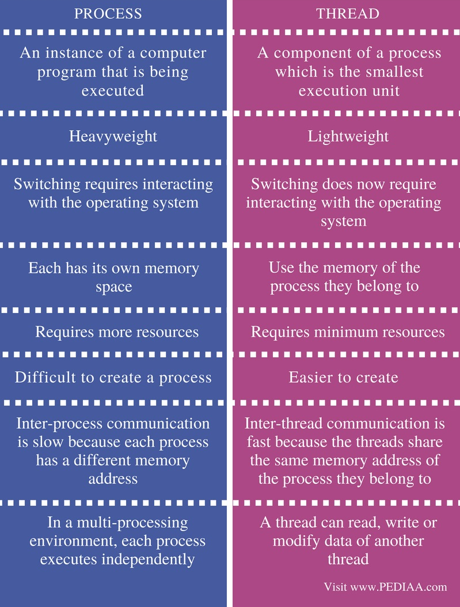
Threads vs Processes
Sharing data
Multi Threading
Multi Processing
Memory
Memory
Memory
Memory
Thread 1
Thread 2
Thread 3
Sub Process 1
Sub Process 2
Sub Process 3

Slide 13
Threads vs Processes
Sharing data
Platform | MPI Shared Memory Bandwidth (GB/sec) | Pthreads Worst Case Memory-to-CPU Bandwidth (GB/sec)
Intel 2.6 GHz Xeon E5-2670 | 4.5 | 51.2
Intel 2.8 GHz Xeon 5660 | 5.6 | 32
AMD 2.3 GHz Opteron | 1.8 | 5.3
AMD 2.4 GHz Opteron | 1.2 | 5.3
IBM 1.9 GHz POWER5 p5-575 | 4.1 | 16
IBM 1.5 GHz POWER4 | 2.1 | 4
Intel 2.4 GHz Xeon | 0.3 | 4.3
Intel 1.4 GHz Itanium 2 | 1.8 | 6.4

Slide 14
Threads vs Processes
Creation
The following table compares timing results for the fork() subroutine and the pthread_create() subroutine. Timings reflect 50,000 process/thread creations, were performed with the time utility, and units are in seconds, no optimization flags.
Platform | fork() |  |  | pthread_create()
 | real | user | sys | real | user | sys
Intel 2.6 GHz Xeon E5-2670 (16 cores/node) | 8.1 | 0.1 | 2.9 | 0.9 | 0.2 | 0.3
Intel 2.8 GHz Xeon 5660 (12 cores/node) | 4.4 | 0.4 | 4.3 | 0.7 | 0.2 | 0.5
AMD 2.3 GHz Opteron (16 cores/node) | 12.5 | 1.0 | 12.5 | 1.2 | 0.2 | 1.3
AMD 2.4 GHz Opteron (8 cores/node) | 17.6 | 2.2 | 15.7 | 1.4 | 0.3 | 1.3
IBM 4.0 GHz POWER6 (8 cpus/node) | 9.5 | 0.6 | 8.8 | 1.6 | 0.1 | 0.4
IBM 1.9 GHz POWER5 p5-575 (8 cpus/node) | 64.2 | 30.7 | 27.6 | 1.7 | 0.6 | 1.1
IBM 1.5 GHz POWER4 (8 cpus/node) | 104.5 | 48.6 | 47.2 | 2.1 | 1.0 | 1.5
INTEL 2.4 GHz Xeon (2 cpus/node) | 54.9 | 1.5 | 20.8 | 1.6 | 0.7 | 0.9
INTEL 1.4 GHz Itanium2 (4 cpus/node) | 54.5 | 1.1 | 22.2 | 2.0 | 1.2 | 0.6
(sec)

Slide 15
Threads vs Processes
thread-safety
Process
static int glob = 0;
static void incr(int loops){
int loc, j;
for (j = 0; j < loops; j++) {
loc = glob;
loc++;
glob = loc;
}
}
glob
Thread 1
Thread 2
Thread 3
incr(int loops)
incr(int loops)
incr(int loops)
For thread safety : execute parallel X -> serialized O

Slide 16
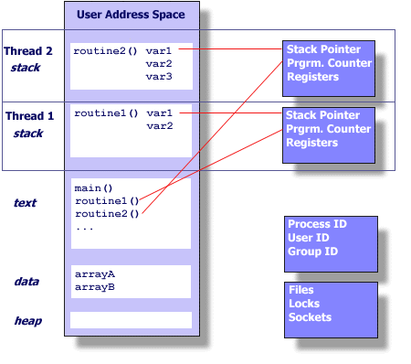
Threads vs Processes
finite virtual memory
UNIX PROCESS
THREADS WITHIN A UNIX PROCESS

Slide 17
Q & A

